Slide 1
COMPUTER ORGANISATION AND ARCHITECTURE
• The components from which computers are built, i.e., computer organization.
• In contrast, computer architecture is the science of integrating those components to achieve a level of functionality and performance.
• The components from which computers are built, i.e., computer organization. • In contrast, computer architecture is the science of integrating those components to achieve a level of functionality and performance.

Slide 2
COMPUTER ORGANIZATION
CO defines functional units of a computer and also the way in which these units are interconnected to form a Computer System.

Slide 3
Computer being electronic machine cannot understand Symbols & Decimal numbers directly.
This led to the development of separate machine language which is in binary form (0’ & 1’s).
Also the Data to be Processed (Symbols, Characters & Numbers) must also be in binary form (0’s & 1’s).
Therefore various methods of representing Natural Language symbols & Decimal Numbers in Binary form inside the Computer Machine constitute Internal Data Representation.
Accordingly Data can be Organized in groups of Binary Digits (BITS), as Multiples of 8 bits say 16, 32, 64 bits.
A group of 8 bits is termed as one Byte. Now this Byte may represent Internally a number, a character, a special symbol etc.
For example, one Byte may look like.
0 1 0 0 0 0 0 1 → denotes character ‘A’

Slide 4
REPRESENTING BINARY INTEGERS
A computer has to process both positive and negative numbers called signed integers and/or simply signed numbers
Binary integer number can be represented using one of the following schemes:
Signed – Magnitude representation
Signed – 1’s complement representation
Signed – 2’s complement representation
For instance consider -13
Now -13 in binary as recorded in an 8-bit register look like:
1 0001101 → signed – magnitude form
1 1110010 → signed – 1’s complement form
1 1110011 → signed – 2’s complement form

Slide 5
2’s complement addition of signed binary numbers
To add two numbers, add their n-bit streams including their sign bits and ignore the carry bit, if any
If any operand is Negative, then convert it into 2’s complement form, before Addition.
If sum obtained is Negative, then it’s in 2’s complement form. Otherwise the result represent Algebraic sum

Slide 6
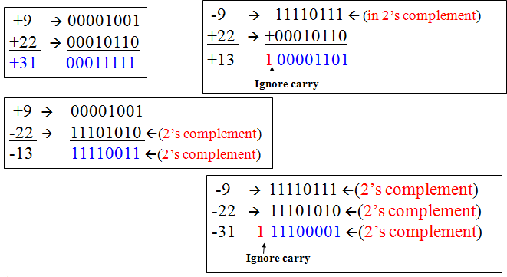
Examples of 2’s complement addition

Slide 7
2’ complement subtraction of signed binary numbers
Take the 2’s complement of the subtrahend (number to be subtracted) and add it to the minuend (including their sign bits). Discard carry bit if any
Suppose, if both minuend and subtrahend are Negative numbers, convert them in to 2’s complement form and perform Addition! Discard carry bit if any.

Slide 8
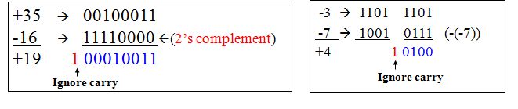

Slide 9
Representing Characters
ASCII Code: For coding alphanumeric data in binary form
ASCII - American Standard Code for Information Interchange.
It uses 7 bit binary code to represent each character.
2⁷ = 128, a maximum of 128 characters can be represented
ASCII code for ‘A’ is 1000001
for ‘a’ is 1100001
EBCDIC Code: For coding alphanumeric data in binary form
EBCDIC - Extended Binary Coded Decimal Interchange Code.
It uses 8 bit binary code to represent each character.
2⁸ = 256, a maximum of 256 characters can be represented

Slide 10
Characters
A memory word can also store character information such as alphabets, decimal digits, symbols like +, -, $, ?, punctuation marks like; :,’ “ etc., Such characters can be represented using a 7-bit ASCII code. Memory Word Bit pattern to represent characters

Slide 11
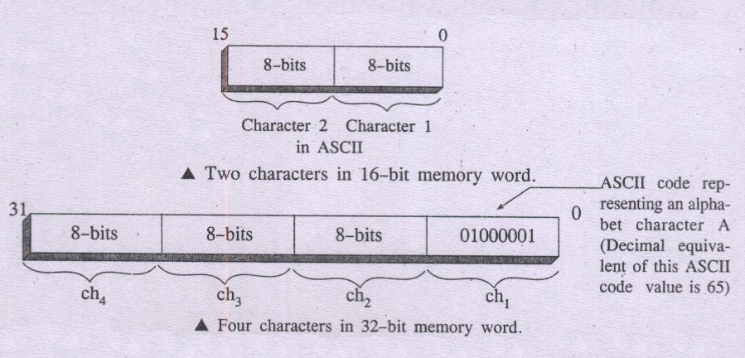

Slide 12
Number Systems

Slide 13

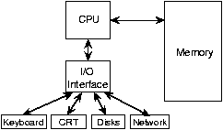
COMPUTER ORGANIZATION
CO defines functional units of a computer and also the way in which these units are interconnected to form a Computer System.
Why CO … ?
CO explore mechanism of operations that are governed and organized by the Basic Structure of a Computer
How Basic Units of a computer interact each other, w.r.t. a set of Instructions and Addressing Modes as supported by the Machine itself !
Thus emphasizing discussions on Basic Structure of Computers.
It is generally said that ‘Nothing has changed the world more rapidly than the emergence of Computers”

Slide 14
Number Systems
A set of values used to represent different quantities is known as Number System“
The digital computer represents all kinds of data and information in binary numbers
The total number of digits used in a number system is called its base or radix.

Slide 15
Common Number Systems
System | Base | Symbols | Used by humans? | Used in computers?
Decimal | 10 | 0, 1, … 9 | Yes | No
Binary | 2 | 0, 1 | No | Yes
Octal | 8 | 0, 1, … 7 | No | No
Hexa- decimal | 16 | 0, 1, … 9, A, B, … F | No | No

Slide 16
Decimal number System
The decimal number system is used in general. However, the computers use binary number system.
The Decimal Number System consists of ten digits from 0 to 9.
These digits can be used to represent any numeric value.
The base of decimal number system is 10.

Slide 17
Quantities/Counting (1 of 3)
Decimal | Binary | Octal | Hexa- decimal
0 | 0 | 0 | 0
1 | 1 | 1 | 1
2 | 10 | 2 | 2
3 | 11 | 3 | 3
4 | 100 | 4 | 4
5 | 101 | 5 | 5
6 | 110 | 6 | 6
7 | 111 | 7 | 7
p. 33

Slide 18
Quantities/Counting (2 of 3)
Decimal | Binary | Octal | Hexa- decimal
8 | 1000 | 10 | 8
9 | 1001 | 11 | 9
10 | 1010 | 12 | A
11 | 1011 | 13 | B
12 | 1100 | 14 | C
13 | 1101 | 15 | D
14 | 1110 | 16 | E
15 | 1111 | 17 | F

Slide 19
Conversion Among Bases
The possibilities:
Decimal
Octal
Binary
Hexadecimal
pp. 40-46

Slide 20
Decimal to Decimal (just for fun)
Decimal
Octal
Binary
Hexadecimal
Next slide…

Slide 21
Weight
125₁₀ => 5 x 10⁰ = 5 2 x 10¹ = 20 1 x 10² = 100 125
Base

Slide 22
Binary to Decimal
Decimal
Octal
Binary
Hexadecimal

Slide 23
Binary to Decimal
Technique
Multiply each bit by 2n, where n is the “weight” of the bit
The weight is the position of the bit, starting from 0 on the right
Add the results

Slide 24
Example
Bit “0”
101011₂ => 1 x 2⁰ = 1 1 x 2¹ = 2 0 x 2² = 0 1 x 2³ = 8 0 x 2⁴ = 0 1 x 2⁵ = 32
43₁₀

Slide 25
Octal to Decimal
Decimal
Octal
Binary
Hexadecimal

Slide 26
Octal to Decimal
Technique
Multiply each bit by 8n, where n is the “weight” of the bit
The weight is the position of the bit, starting from 0 on the right
Add the results

Slide 27
Example
724₈ => 4 x 8⁰ = 4 2 x 8¹ = 16 7 x 8² = 448 468₁₀

Slide 28
Hexadecimal to Decimal
Decimal
Octal
Binary
Hexadecimal

Slide 29
Hexadecimal to Decimal
Technique
Multiply each bit by 16n, where n is the “weight” of the bit
The weight is the position of the bit, starting from 0 on the right
Add the results

Slide 30
Example
ABC₁₆ => C x 16⁰ = 12 x 1 = 12 B x 16¹ = 11 x 16 = 176 A x 16² = 10 x 256 = 2560
2748₁₀

Slide 31
Decimal to Binary
Decimal
Octal
Binary
Hexadecimal

Slide 32
Decimal to Binary
Technique
Divide by two, keep track of the remainder
First remainder is bit 0 (LSB, least-significant bit)
Second remainder is bit 1
Etc.

Slide 33
Example
125₁₀ = ?₂
2 125 62 1
2 31 0
2 15 1
2 7 1
2 3 1
2 1 1
2 0 1
125₁₀ = 1111101₂

Slide 34
Octal to Binary
Decimal
Octal
Binary
Hexadecimal

Slide 35
Octal to Binary
Technique
Convert each octal digit to a 3-bit equivalent binary representation

Slide 36
Example
705₈ = ?₂
7 0 5
111 000 101
705₈ = 111000101₂

Slide 37
Hexadecimal to Binary
Decimal
Octal
Binary
Hexadecimal

Slide 38
Hexadecimal to Binary
Technique
Convert each hexadecimal digit to a 4-bit equivalent binary representation

Slide 39
Example
10AF₁₆ = ?₂
1 0 A F
0001 0000 1010 1111
10AF₁₆ = 0001000010101111₂

Slide 40
Decimal to Octal
Decimal
Octal
Binary
Hexadecimal

Slide 41
Decimal to Octal
Technique
Divide by 8
Keep track of the remainder

Slide 42
Example
1234₁₀ = ?₈
8 1234
154 2
8
19 2
8
2 3
8
0 2
1234₁₀ = 2322₈

Slide 43
Decimal to Hexadecimal
Decimal
Octal
Binary
Hexadecimal

Slide 44
Decimal to Hexadecimal
Technique
Divide by 16
Keep track of the remainder

Slide 45
Example
1234₁₀ = ?₁₆
16 1234
77 2
16
4 13 = D
16
0 4
1234₁₀ = 4D2₁₆

Slide 46
Binary to Octal
Decimal
Octal
Binary
Hexadecimal

Slide 47
Binary to Octal
Technique
Group bits in threes, starting on right
Convert to octal digits

Slide 48
Example
1011010111₂ = ?₈
1 011 010 111
1 3 2 7
1011010111₂ = 1327₈

Slide 49
Binary to Hexadecimal
Decimal
Octal
Binary
Hexadecimal

Slide 50
Binary to Hexadecimal
Technique
Group bits in fours, starting on right
Convert to hexadecimal digits

Slide 51
Example
1010111011₂ = ?₁₆
10 1011 1011
B B
1010111011₂ = 2BB₁₆

Slide 52
Octal to Hexadecimal
Decimal
Octal
Binary
Hexadecimal

Slide 53
Octal to Hexadecimal
Technique
Use binary as an intermediary

Slide 54
Example
1076₈ = ?₁₆
1 0 7 6
001 000 111 110
2 3 E
1076₈ = 23E₁₆

Slide 55
Hexadecimal to Octal
Decimal
Octal
Binary
Hexadecimal

Slide 56
Hexadecimal to Octal
Technique
Use binary as an intermediary

Slide 57
Example
1F0C₁₆ = ?₈
1 F 0 C
0001 1111 0000 1100
1 7 4 1 4
1F0C₁₆ = 17414₈

Slide 58
Exercise – Convert ...
Decimal | Binary | Octal | Hexa- decimal
33
 | 1110101
 |  | 703
 |  |  | 1AF
Don’t use a calculator!
Skip answer
Answer

Slide 59
Fractions
Decimal to decimal (just for fun)
3.14 => 4 x 10⁻² = 0.04 1 x 10⁻¹ = 0.1 3 x 10⁰ = 3 3.14
pp. 46-50

Slide 60
Fractions
Binary to decimal
10.1011 => 1 x 2⁻⁴ = 0.0625 1 x 2⁻³ = 0.125 0 x 2⁻² = 0.0 1 x 2⁻¹ = 0.5 0 x 2⁰ = 0.0 1 x 2¹ = 2.0 2.6875
pp. 46-50

Slide 61
Fractions
.14579 x 2 0.29158 x 2 0.58316 x 2 1.16632 x 2 0.33264 x 2 0.66528 x 2 1.33056
etc.
Decimal to binary
3.14579
11.001001...
p. 50

Slide 62
need to represent both positive and negative numbers. Three systems are used for representing such numbers :
Sign-and-magnitude
1’s-complement
2’s-complement

Slide 63
In all three systems, the leftmost bit is 0 for positive numbers and 1 for negative numbers. Fig 2.1 illustrates all three representations using 4-bit numbers. Positive values have identical representations in al systems, but negative values have different representations

Slide 64
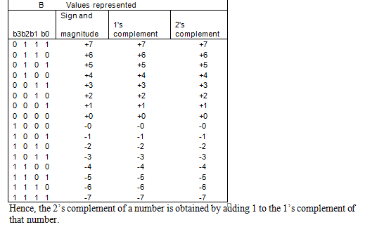

Slide 65
Binary arithmetic
Binary arithmetic is essential part of all the digital computers and many other digital system.
Binary Addition
It is a key for binary subtraction, multiplication, division. There are four rules of the binary addition.

Slide 66
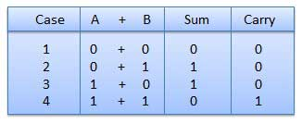
Binary Addition

Slide 67
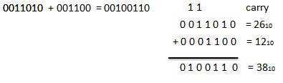
Binary Addition
In fourth case, a binary addition is creating a sum of (1+1=10) i.e. 0 is write in the given column and a carry of 1 over to the next column.
EXAMPLE - ADDITION

Slide 68
Binary Subtraction
Subtraction and Borrow, these two words will be used very frequently for the binary subtraction. There four rules of the binary subtraction. There are four rules of the binary Subtraction.

Slide 69
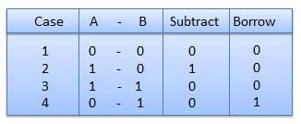
Binary Subtraction

Slide 70
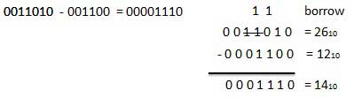
EXAMPLE - SUBTRACTION

Slide 71
Binary Multiplication
Binary multiplication is similar to decimal multiplication. It is simpler than decimal multiplication because only 0s and 1s are involved.There four rules of the binary multiplication.

Slide 72
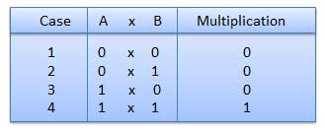
Binary Multiplication

Slide 73
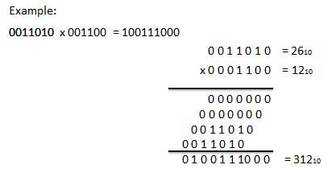
EXAMPLE - MULTIPLICATION

Slide 74
Binary Division
Binary division is similar to decimal division. It is called as the long division procedure

Slide 75
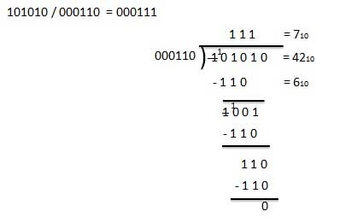
EXAMPLE - DIVISION

Slide 76
Half Adder
Half adder is a combinational logic circuit with two input and two output. The half adder circuit is designed to add two single bit binary number A and B. It is the basic building block for addition of two single bit numbers. This circuit has two outputs carry and sum.

Slide 77
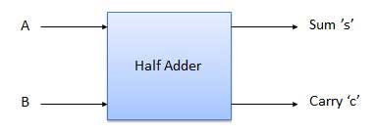
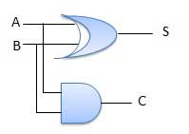
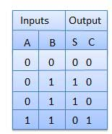
BLOCK DIAGRAM

Slide 78
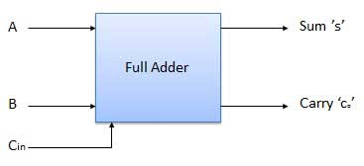
Full Adder
Full adder is developed to overcome the drawback of Half Adder circuit. It can add two one-bit numbers A and B, and carry c. The full adder is a three input and two output combinational circuit.

Slide 79
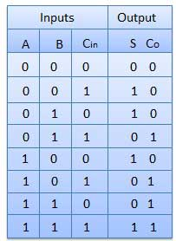
Full Adder

Slide 80
Half Subtractors
Half subtractor is a combination circuit with two inputs and two outputs (difference and borrow). It produces the difference between the two binary bits at the input and also produces a output (Borrow) to indicate if a 1 has been borrowed. In the subtraction (A-B), A is called as Minuend bit and B is called as Subtrahend bit.

Slide 81
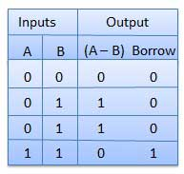
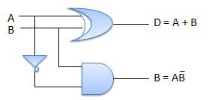
Truth table and circuit diagram

Slide 82
Full Subtractors
The disadvantage of a half subtractor is overcome by full subtractor. The full subtractor is a combinational circuit with three inputs A,B,C and two output D and C'. A is the minuend, B is subtrahend, C is the borrow produced by the previous stage, D is the difference output and C' is the borrow output.

Slide 83
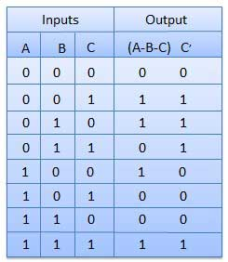
TRUTH TABLE

Slide 84
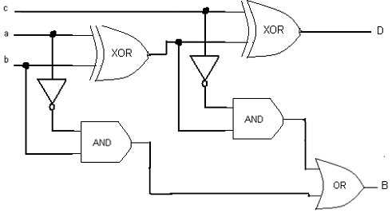
FULL ADDER: CIRCUIT DIAGRAM

Slide 85
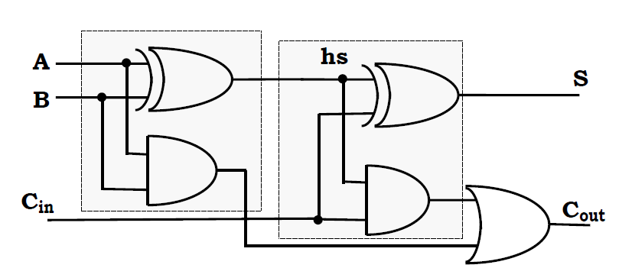
FULL ADDER: CIRCUIT DIAGRAM

Slide 86
Ripple Carry Adder
Typical Ripple Carry Addition is a Serial Process:
• Addition starts by adding LSBs of the augend and addend.
• Then next position bits of augend and addend are added along with the carry (if
any) from the preceding bit.
• This process is repeated until the addition of MSBs is completed.

Slide 87
Carry Propagation
• Speed of a ripple adder is limited due to carry propagation or carry ripple.
• Sum of MSB depends on the carry generated by LSB.
For example.
4-bit Carry Ripple Adder

Slide 88
Carry Propagation
Assume you want to add two operands A and B where
A= A3 A2 A1 A0
B=B3 B2 B1 B0
For example: A= 1 0 1 1 +
B= 1 1 0 1
---------------
A+B= 11 0 0 0 = C out S3 S2 S1 S0

Slide 89
Carry Propagation
From the example above it can be seen that we are adding 3 bits at atime sequentially until all bits are added. A full adder is a combinational circuit that performs the arithmetic sum of three input bits: augends Ai, addend Bi and carry in Cin from the previous adder. Its results contain the sum Si and the carry out, Cout to the next stage.

Slide 90
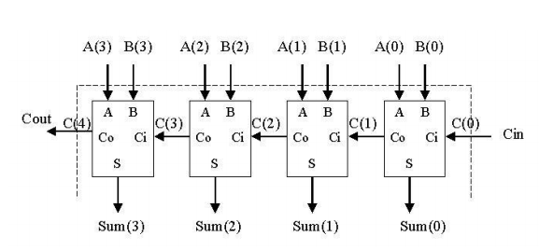
4-Bit Adder

Slide 91
4 BIT ADDER
So to design a 4-bit adder circuit we start by designing the 1 –bit full adder then connecting the four 1-bit full adders to get the 4-bit adder as shown in the diagram above. For the 1-bit full adder, the design begins by drawing the Truth Table for the three input and the corresponding output SUM and CARRY. The Boolean Expression describing the binary adder circuit is then deduced. The binary full adder is a three input combinational circuit which satisfies the truth table below.

Slide 92
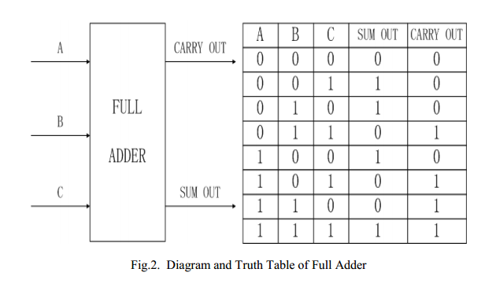
Full adder

Slide 93
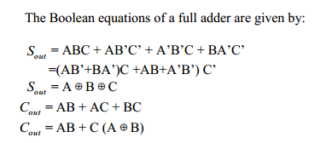
Full adder

Slide 94
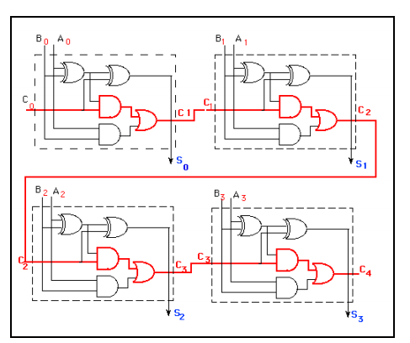
Full adder

Slide 95
carry-lookahead adders
A carry-lookahead adders (CLA) is a type of adder used in digital logic. A carry-lookahead adder improves speed by reducing the amount of time required to determine carry bits.
It can be contrasted with the simpler, but usually slower,ripple carry adder for which the carry bit is calculated alongside the sum bit, and each bit must wait until the previous carry has been calculated to begin calculating its own result and carry bits (see adder for detail on ripple carry adders).

Slide 96
The carry-lookahead adder calculates one or more carry bits before the sum, which reduces the wait time to calculate the result of the larger value bits.
In a ripple adder the delay of each adder is 10 ns , then for 4 adders the delay will be 40 ns .
To overcome this delay Carry Look-Ahead Adder is used

Slide 97
carry-lookahead adders
Accordingly, reducing the carry propagation delay of adders is of great importance. Different logic design approaches have been employed to overcome the carry propagation problem.
One widely used approach employs the principle of carry look-ahead solves this problem by calculating the carry signals in advance, based on the input signals.

Slide 98
carry-lookahead adders
This type of adder circuit is called as carry look-ahead adder (CLA adder). It is based on the fact that a carry signal will be generated in two cases:
(1) when both bits Ai and Bi are 1, or
(2) when one of the two bits is 1 and the carry-in (carry of the previous stage) is 1.

Slide 99
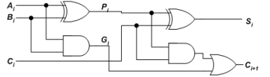
The Figure shows the full adder circuit used to add the operand bits in the I th column; namely Ai & Bi and the carry bit coming from the previous column (Ci ).

Slide 100


In this circuit, the 2 internal signals Pi and Gi are given by:
The output sum and carry can be defined as :

Slide 101
Gi is known as the carry Generate signal since a carry (Ci+1) is generated whenever Gi =1, regardless of the input carry (Ci).
Pi is known as the carry propagate signal since whenever Pi =1, the input carry is propagated to the output carry, i.e., Ci+1. = Ci (note that whenever Pi =1, Gi =0).

Slide 102
Computing the values of Pi and Gi only depend on the input operand bits (Ai & Bi) as clear from the Figure and equations.
Thus, these signals settle to their steady-state value after the propagation through their respective gates.

Slide 103
Computed values of all the Pi’s are valid one XOR-gate delay after the operands A and B are made valid.
Computed values of all the Gi’s are valid one AND-gate delay after the operands A and B are made valid.
The Boolean expression of the carry outputs of various stages can be written as follows:

Slide 104
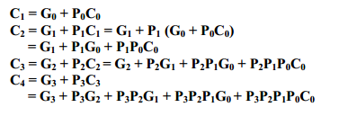

Slide 105
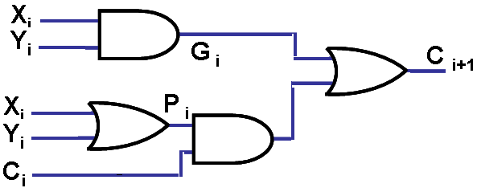
Design of Fast Adders:
Carry C_{i+1} = X_{i}Y_{i} + Y_{i}C_{i} + C_{i}X_{i}
= X_{i}Y_{i} + C_{i} (X_{i} +Y_{i})
= G_{i} + C_{i}P_{i}. (Generate Carry + C_{i}* Propagate Carry)
Carry C_{i+1} = G_{i} + C_{i}P_{i}
i.e. C_{i} = (G_{i-1} + P_{i-1}C_{i-1}) &
C_{i-1} = (G_{i-2} + P_{i-2}C_{i-2}).

Slide 106
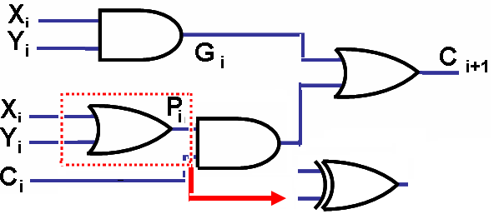
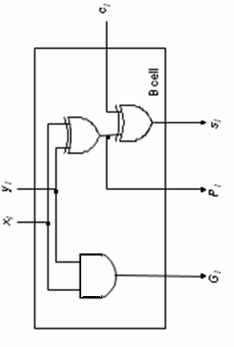
Design of Fast Adders:
C_{i+1} = G_{i} + C_{i}P_{i}.
always, except when X_{i} = 1 & Y_{i} = 1. But, then Gi = 1to make C_{i+1} = 1; hence Bit cell

Slide 107
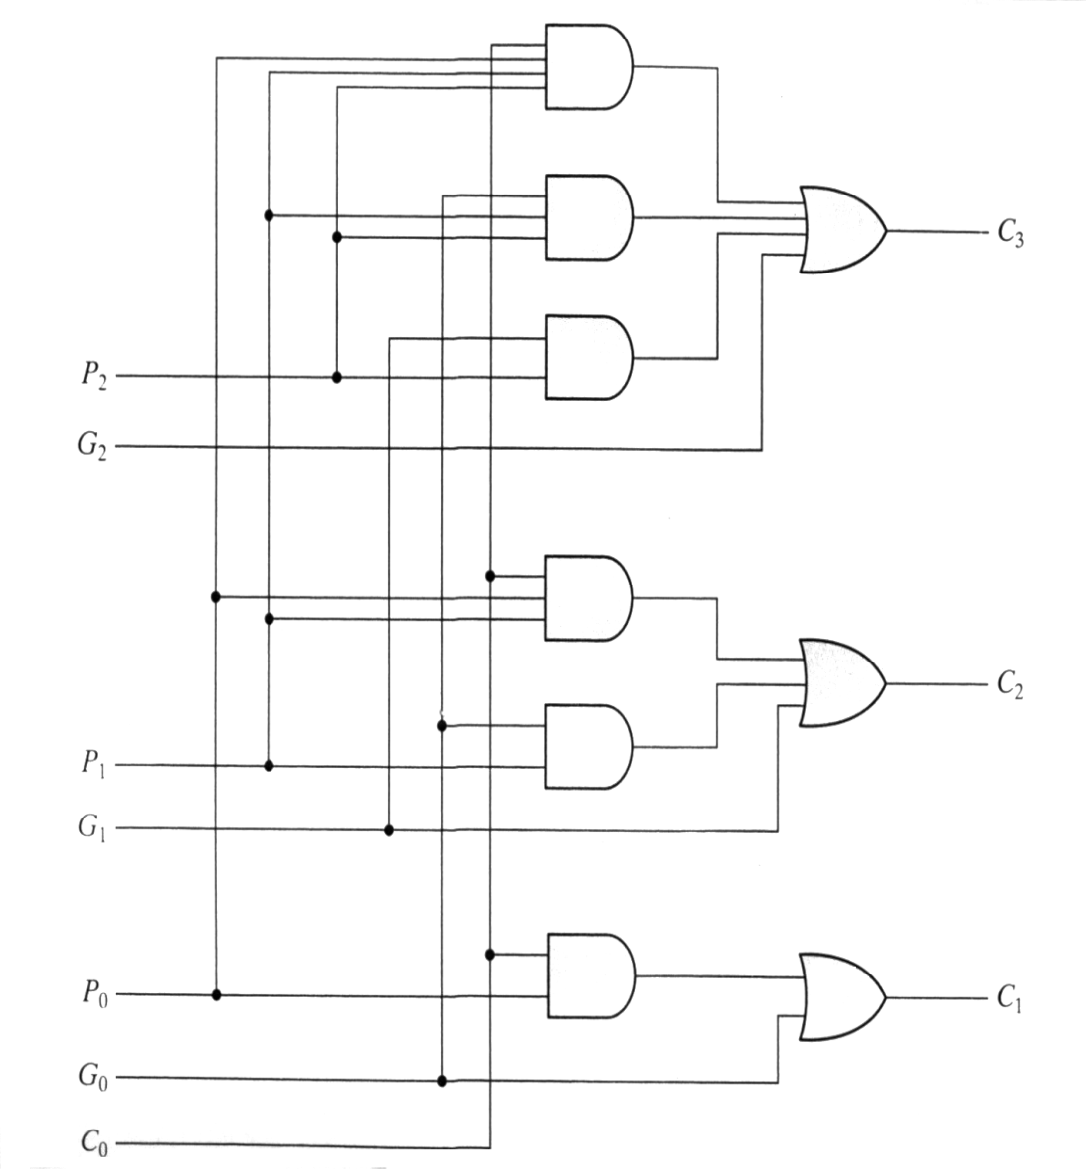
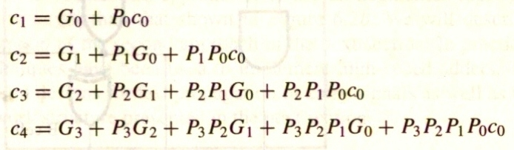
Implementing these expressions (for a 4-bit adder), results in the logic diagram. (IC- 74182)

Slide 108
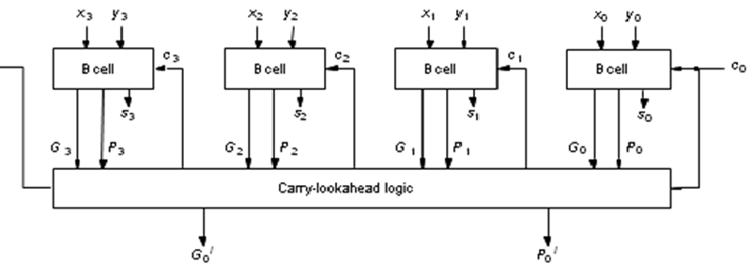
Design of Fast Adders:
i ^{th} stage C _{i+1} = G _{i} + P_{i}G _{i-1} +
P_{i}P _{i-1} G _{i-2} + … + P_{i} P _{i-1} … P ₁G₀ +
P_{i} P _{i-1} … P₀G_{0.}
_{C4} Where G i = XiYi & Pi = (Xi + Yi)
or =(Xi Yi)

Slide 109
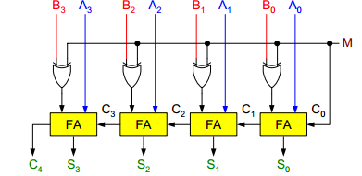
Binary Parallel Adder/Subtractor:
The addition and subtraction operations can be done using an Adder-Subtractor circuit.
The figure shows the logic diagram of a 4-bit Adder-Subtractor circuit.

Slide 110
Binary Parallel Adder/Subtractor:
The circuit has a mode control signal M which determines if the circuit is to operate as an adder or a subtractor.
Each XOR gate receives input M and one of the inputs of B, i.e., Bi. To understand the behavior of XOR gate consider its truth table given below.

Slide 111
If one input of XOR gate is zero then the output of XOR will be same as the second input. While if one input of XOR gate is one then the output of XOR will be complement of the second input.

Slide 112

Binary Parallel Adder/Subtractor:

Slide 113
Binary Parallel Adder/Subtractor:
So when M = 0, the output of XOR gate will be Bi ⊕ 0 = Bi. If the full adders receive the value of B, and the input carry C0 is 0, the circuit performs A plus B.
When M = 1, the output of XOR gate will be Bi ⊕ 1 = Bi. If the full adders receive the value of B’, and the input carry C0 is 1, the circuit performs A plus 1’s complement of B plus 1, which is equal to A minus B.

Slide 114
Binary Multiplier:
Multiplication of binary numbers is performed in the same way as with decimal numbers. The multiplicand is multiplied by each bit of the multiplier, starting from the least significant bit.
The result of each such multiplication forms a partial product. Successive partial products are shifted one bit to the left.

Slide 115
Binary Multiplier:
The product is obtained by adding these shifted partial products.
Example 1: Consider an example of multiplication of two numbers, say A and B (2 bits each),
C = A x B.

Slide 116
Binary Multiplier:
Unsigned number multiplication
two n-bit numbers; 2n-bit result
(13) 1 1 0 1 X 1 0 1 1 (11)
1 1 0 1
1 1 0 1
0 0 0 0
1 1 0 1
1 0 0 0 1 1 1 1 (143)

Slide 117
Binary Multiplier:
The first partial product is formed by multiplying the B1B0 by A0. The multiplication of two bits such as A0 and B0 produces a 1 if both bits are 1; otherwise it produces a 0 like an AND operation. So the partial products can be implemented with AND gates.

Slide 118
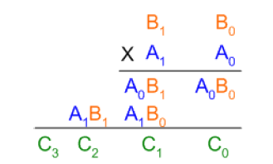
Binary Multiplier:
The second partial product is formed by multiplying the B1B0 by A1 and is shifted one position to the left.

Slide 119
Binary Multiplier:
The two partial products are added with two half adders (HA). Usually there are more bits in the partial products, and then it will be necessary to use FAs.

Slide 120
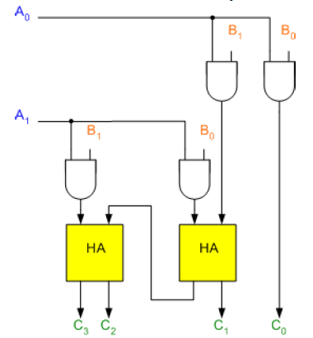
Binary Multiplier:

Slide 121
Binary Multiplier:
The least significant bit of the product does not have to go through an adder, since it is formed by the output of the first AND gate as shown in the Figure.

Slide 122
Multiplication

Slide 123
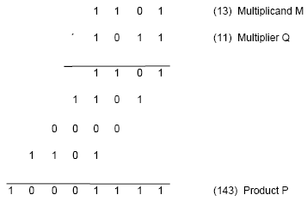
Multiplication of unsigned numbers
Product of 2 n-bit numbers is at most a 2n-bit number.
Unsigned multiplication can be viewed as addition of shifted
versions of the multiplicand.

Slide 124
Multiplication of unsigned numbers (contd..)
We added the partial products at end.
Alternative would be to add the partial products at each stage.
Rules to implement multiplication are:
If the i^{th} bit of the multiplier is 1, shift the multiplicand and add the shifted multiplicand to the current value of the partial product.
Hand over the partial product to the next stage
Value of the partial product at the start stage is 0.

Slide 125
Sequential multiplication
Recall the rule for generating partial products:
If the ith bit of the multiplier is 1, add the appropriately shifted multiplicand to the current partial product.
Multiplicand has been shifted left when added to the partial product.
However, adding a left-shifted multiplicand to an unshifted partial product is equivalent to adding an unshifted multiplicand to a right-shifted partial product.

Slide 126
Sequential multiplication (contd..)
M
1 1 0 1
Initial configuration
0
0 0 0 0
1 0 1 1
C
A
Q
0
1 1 0 1
1 0 1 1
Add
First cycle
0
0 1 1 0
1 1 0 1
Shift
1
0 0 1 1
1 1 0 1
Add
Second cycle
0
1 0 0 1
1 1 1 0
Shift
0
1 0 0 1
1 1 1 0
No add
Third cycle
0
0 1 0 0
1 1 1 1
Shift
1
0 0 0 1
1 1 1 1
Add
0
1 0 0 0
1 1 1 1
Shift
Fourth cycle
Product

Slide 127
Signed Multiplication

Slide 128
Signed Multiplication
Considering 2’s-complement signed operands, what will happen to (-13)×(+11) if following the same method of unsigned multiplication?
1
0
0
1
1
(
-
13
)
0
1
0
1
1
(
+
11
)
1
1
1
1
1
1
0
0
1
1
1
1
1
1
1
0
0
1
1
Sign extension is
0
0
0
0
0
0
0
0
shown in blue
1
1
1
0
0
1
1
0
0
0
0
0
0
1
1
0
1
1
1
0
0
0
1
(
-
143
)
Sign extension of negative multiplicand.

Slide 129
Signed Multiplication
For a negative multiplier, a straightforward solution is to form the 2’s-complement of both the multiplier and the multiplicand and proceed as in the case of a positive multiplier.
This is possible because complementation of both operands does not change the value or the sign of the product.
A technique that works equally well for both negative and positive multipliers – Booth algorithm.

Slide 130
Booth Algorithm
Consider in a multiplication, the multiplier is positive 0011110, how many appropriately shifted versions of the multiplicand are added in a standard procedure?
0
1
0
1
1
0
1
0
0
+
1
+
1
+
1
+
1
0
0
0
0
0
0
0
0
0
1
0
1
1
0
1
0
1
0
1
1
0
1
0
1
0
1
1
0
1
0
1
0
1
1
0
1
0
0
0
0
0
0
0
0
0
0
0
0
0
0
0
0
0
1
0
1
0
1
0
0
0
1
1
0

Slide 131
Booth Algorithm
Since 0011110 = 0100000 – 0000010, if we use the expression to the right, what will happen?
0
1
0
1
1
0
1
0
+
1
0
0
0
-
1
0
0
0
0
0
0
0
0
0
0
0
0
0
0
0
2's complement of
1
1
1
1
1
1
1
0
1
0
0
1
1
the multiplicand
0
0
0
0
0
0
0
0
0
0
0
0
0
0
0
0
0
0
0
0
0
0
0
0
0
0
0
0
0
0
0
0
0
0
0
0
1
0
1
1
0
1
0
0
0
0
0
0
0
0
0
0
0
1
0
1
0
1
0
0
0
1
1
0

Slide 132
Booth Algorithm
In general, in the Booth scheme, -1 times the shifted multiplicand is selected when moving from 0 to 1, and +1 times the shifted multiplicand is selected when moving from 1 to 0, as the multiplier is scanned from right to left.
0
0
1
0
1
1
0
0
1
1
1
0
1
0
1
1
0
0
0
+
1
-
1
+
1
0
-
1
0
+
1
0
0
-
1
+
1
-
1
+
1
0
-
1
0
0
Booth recoding of a multiplier.

Slide 133
Booth Algorithm
0
1
1
0
1
(
+
13
)
0
1
1
0
1
X
1
1
0
1
0
(
-
6
)
0
-
1
+1
-
1
0
0
0
0
0
0
0
0
0
0
0
1
1
1
1
1
0
0
1
1
0
0
0
0
1
1
0
1
1
1
1
0
0
1
1
0
0
0
0
0
0
1
1
1
0
1
1
0
0
1
0
(
-
78
)
Booth multiplication with a negative multiplier.

Slide 134
Booth Algorithm
Multiplier
V
ersion of multiplicand
selected by bit
i
Bit
i
Bit
i
-
1
0
0
0
X
M
0
1
+
1
X
M
1
0
−
1
X
M
1
1
0
X
M
Booth multiplier recoding table.

Slide 135
Booth algorithm
Booth algorithm treats both +ve &
-ve operands equally.
(a) + Md X + Mr
Ex: 0 1 1 0 1 (+13) X 0 1 0 1 1 (+11)
+1-1+1 0 -1
0 0 0 0 0 0 0 0 0 0
1 1 1 1 1 1 0 0 1 1
0 0 0 0 0 0 0 0 0
0 0 0 0 1 1 0 1
1 1 1 0 0 1 1
0 0 1 1 0 1
0 0 1 0 0 0 1 1 1 1 (+143)

Slide 136
Booth algorithm
Booth algorithm treats both +ve &
-ve operands equally.
(b) - Md X + Mr
Ex: 1 0 0 1 1 (-13) X 0 1 0 1 1 (+11)
+1-1+1 0 -1
0 0 0 0 0 0 0 1 1 0 1
0 0 0 0 0 0 0 0 0 0
1 1 1 1 1 0 0 1 1
0 0 0 0 0 1 1 0 1
1 1 1 0 0 1 1
1 0 1 0 0 0 0 0 0 1 (-143)

Slide 137
Booth algorithm
Booth algorithm treats both +ve &
-ve operands equally.
(c) + Md X - Mr
Ex: 0 1 1 0 1 (+13) X 1 0 1 0 1 (-11)
-1+1-1 +1-1
0 0 0 0 0 0 0 0 0 0
1 1 1 1 1 1 0 0 1 1
0 0 0 0 0 1 1 0 1
1 1 1 1 0 0 1 1
0 0 0 1 1 0 1
1 1 0 0 1 1
1 1 0 1 1 1 0 0 0 1 1 0 1 0 0 0 1 1 1 1 (-143)

Slide 138
Booth algorithm
Booth algorithm treats both +ve &
-ve operands equally.
(d) - Md X - Mr
Ex: 1 0 0 1 1 (-13) X 0 0 1 0 1 (-11)
-1+1-1 +1 -1
0 0 0 0 0 0 0 0 0 0
0 0 0 0 0 0 1 1 0 1
1 1 1 1 1 0 0 1 1
0 0 0 0 1 1 0 1
1 1 1 0 0 1 1
0 0 1 1 0 1
0 0 1 0 0 0 1 1 1 1 (+143)

Slide 139
Fast Multiplication

Slide 140
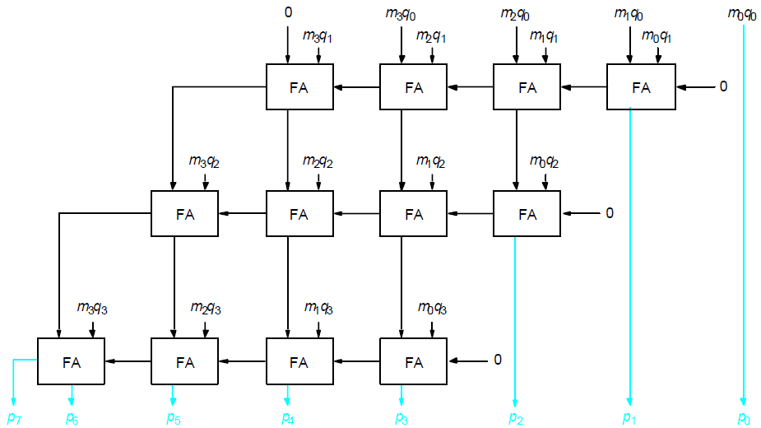
Carry-Save Addition of Summands
CSA speeds up the addition process.
P7
P6
P5
P4
P3
P2
P1
P0

Slide 141
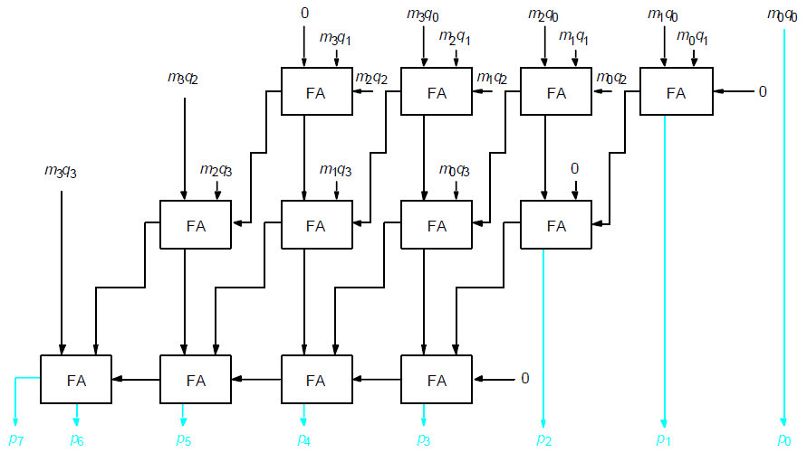
Carry-Save Addition of Summands(Cont.,)
P7
P6
P5
P4
P3
P2
P1
P0

Slide 142
Carry-Save Addition of Summands(Cont.,)
Consider the addition of many summands, we can:
Group the summands in threes and perform carry-save addition on each of these groups in parallel to generate a set of S and C vectors in one full-adder delay
Group all of the S and C vectors into threes, and perform carry-save addition on them, generating a further set of S and C vectors in one more full-adder delay
Continue with this process until there are only two vectors remaining
They can be added in a RCA or CLA to produce the desired product

Slide 143
Carry-Save Addition of Summands
1
0
1
1
0
1
(45)
M
X
1
1
1
1
1
1
(63)
Q
1
0
1
1
0
1
A
1
0
1
1
0
1
B
1
0
1
1
0
1
C
1
0
1
1
0
1
D
1
0
1
1
0
1
E
1
0
1
1
0
1
F
1
0
1
1
0
0
0
1
0
0
1
1
(2,835)
Product
Figure 6.17. A multiplication example used to illustrate carry-save addition as shown in Figure 6.18.

Slide 144
1
0
1
1
0
1
M
x
1
1
1
1
1
1
Q
1
0
1
1
0
1
A
1
0
1
1
0
1
B
1
0
1
1
0
1
C
1
1
0
0
0
0
1
1
S
1
0
0
1
1
1
1
0
0
C
1
1
0
1
1
0
1
D
1
0
1
1
0
1
E
1
0
1
1
0
1
F
1
1
0
0
0
0
1
1
S
2
0
0
1
1
1
1
0
0
C
2
1
1
0
0
0
0
1
1
S
1
0
0
1
1
1
1
0
0
C
1
1
1
0
0
0
0
1
1
S
2
1
1
0
1
0
1
0
0
0
1
1
S
3
0
0
0
0
1
0
1
1
0
0
0
C
3
0
0
1
1
1
1
0
0
C
2
0
1
0
1
1
1
0
1
0
0
1
1
S
4
+
0
1
0
1
0
1
0
0
0
0
0
C
4
1
0
1
1
0
0
0
1
0
0
1
1
Product
Figure 6.18. The multiplication example from Figure 6.17 performed using
carry-save addition.

Slide 145
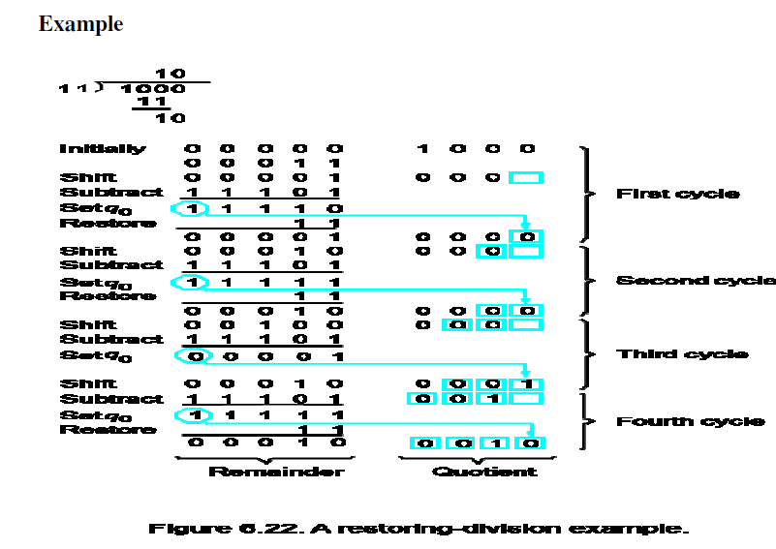
Restoring Division

Slide 146
Unsigned division
Division is a more tedious process than multiplication.
For the unsigned case, there are two standard approaches:
1.) Restoring division. 2.) Non restoring division.
13
21
1101
10101
274
100010010
26
1101
14
10000
13
1101
1
1110
Try dividing 13 into 2.
Try dividing 13 into 26.
1101
1
Try dividing 1101 into 1, 10, 100, 1000
and 10001.

Slide 147
Restoring division
How do we know when the divisor has gone into part of the dividend
correctly?
1101
10101
100010010
1101
Subtract 1101 from 1, result is negative
Subtract 1101 from 10, result is negative.
Subtract 1101 from 100, result is negative
Subtract 1101 from 1000, result is negative.
Subtract 1101 from 10001, result is positive.
10000
1101
1110
1101
1

Slide 148
Restoring division
Strategy for unsigned division:
Shift the dividend one bit at a time starting from MSB into a register.
Subtract the divisor from this register.
If the result is negative (“didn’t go”):
- Add the divisor back into the register.
- Record 0 into the result register.
If the result is positive:
- Do not restore the intermediate result.
- Set a 1 into the result register.

Slide 149
Restoring division (contd..)
Initially
0
0
0
0
0
1
0
0
0
0
0
0
1
1
Shift
0
0
0
0
1
0
0
0
Subtract
1
1
1
0
1
First cycle
Set
q
0
1
1
1
1
0
Restore
1
1
1
0
0
0
0
0
1
0
0
0
0
1
1
1
0
0
0
Shift
0
0
0
1
0
0
0
0
1
1
Subtract
1
1
1
0
1
1
Set
q
1
1
1
1
1
Second cycle
1
0
0
Restore
1
1
0
0
0
1
0
0
0
0
0
Shift
0
0
1
0
0
0
0
0
Subtract
1
1
1
0
1
Set
q
0
0
0
0
0
1
Third cycle
Shift
0
0
0
1
0
0
0
0
1
Subtract
1
1
1
0
1
0
0
1
Set
q
0
1
1
1
1
1
Fourth cycle
Restore
1
1
0
0
0
1
0
0
0
1
0
Remainder
Quotient

Slide 150
Non-restoring division
Restoring division can be improved using non-restoring algorithm
The effect of restoring algorithm actually is:
If A is positive, we shift it left and subtract M, that is compute 2A-M
If A is negative, we restore it (A+M), shift it left, and subtract M, that
is, 2(A+M) – M = 2A+M.
Set q₀ to 1 or 0 appropriately.
Non-restoring algorithm is:
Set A to 0.
Repeat n times:
If the sign of A is positive:
Shift A and Q left and subtract M. Set q0 to 1.
Else if the sign of A is negative:
Shift A and Q left and add M. Set q0 to 0.
If the sign of A is 1, add A to M.

Slide 151
Non-restoring division (contd..)
Initially
0
0
0
0
0
1
0
0
0
0
0
0
1
1
Shift
0
0
0
0
1
0
0
0
First cycle
Subtract
1
1
1
0
1
Set
q
0
1
1
1
1
0
0
0
0
0
Shift
1
1
1
0
0
0
0
0
Add
0
0
0
1
1
Second cycle
1
0
Set
q
0
1
1
1
1
1
0
0
0
0
1
1
1
0
0
0
1
1
Shift
1
1
1
1
0
0
0
0
1
Add
0
0
0
1
1
Third cycle
1
0
Set
q
0
0
0
0
0
1
0
0
0
1
Shift
0
0
0
1
0
0
0
1
Subtract
1
1
1
0
1
Fourth cycle
Set
q
0
1
1
1
1
1
0
0
1
0
Quotient
1
1
1
1
1
Add
0
0
0
1
1
Restore
remainder
0
0
0
1
0
Remainder

